Slide 1
HIV Primary Care Guidelines
Presented by:
Michael Serlin, MD
Regional Medical Director, AbsoluteCare
Clinical Associate Professor of Medicine,
George Washington University School of Medicine and Health Sciences
March 20, 2025

Slide 2
Acknowledgement
The MidAtlantic AIDS Education and Training Center (MAAETC) is supported by DHHS, Health Resources and Services Administration (HRSA) as part of a cooperative agreement of $2,917,621 and 0% financed with non-governmental sources. The program aims to provides HIV training and technical assistance to USPHS Region 3 (Pennsylvania, Maryland, Delaware, the District of Columbia, Virginia, and West Virginia).
The contents in this presentation are those of the author(s) and do not necessarily represent the official views of, nor an endorsement, by HRSA, HHS, or the U.S. Government. For more information, please visit HRSA.gov.

Slide 3
Disclaimer
Funding for this presentation was made possible in part by U1OHA29295 from the Health Resources and Services Administration HIV/AIDS Bureau. The views expressed do not necessarily reflect the official policies of the Department of Health and Human Services nor does mention of trade names, commercial practices, or organizations imply endorsement by the U.S. Government. Any trade/brand names for products mentioned during this presentation are for training and identification purposes only.

Slide 4
Planning Disclosure
The staff and faculty involved with the planning of today’s event do not have any conflicts of interest to disclose.
Notes:
READ SLIDE

Slide 5
Speaker Disclosure
Medical Advisor, Viiv.
Notes:
*Start Audio*
At this time I would ask our speaker to please disclose any commercial relationships that he/she may have.

Slide 6
Needs
We have attempted to make this presentation compliant with the Americans with Disabilities Act and Section 508 of the Rehabilitation Act.
If you find that you need further accommodation, or alternate means to utilize this presentation, please contact us and we will attempt to further accommodate your needs.

Slide 7
Objectives
Upon completion of this course, the participant will be able to:
Describe required screenings to initiate primary care for an individual with HIV
Describe routine tests to optimize care for patients with HIV
Describe preventive medical screening for patients with HIV

Slide 8
Primary Care Guidelines for Management of HIV
Updated guidelines from IDSA and HIVMA updated in 2020
As patients live longer, healthier lives on ARV, need to concentrate on age- and sex- related health problems as well
New guidelines incorporate both HIV specific care as well as age related care

Slide 11
Upon Initiation of Care
A comprehensive present and past medical history,
  Physical examination,
  Medication/social/family history,
    Ensure addressing patients using appropriate pronouns
  Review of systems, including HIV-related information, should be obtained for all patients upon initiation of care
Patients who have no documentation of their HIV serostatus or who were tested anonymously should have an HIV serologic test performed upon initiation of care

Slide 12
Past Medical History

Slide 13
Social History

Slide 14
Physical Exam

Slide 15
Upon Initiation of Care
Labs:
  CD4 / VL
  Genotype prior to starting meds (because of risk of superinfection) (including integrase for those failing INSTIs)
    No Integrase resistance testing for naïve patients due to low risk of transmitted intergrase resistance at this time
  CCR5 if considering starting maraviroc
  HLAB5701 if considering starting Abacavir based regimen
  CBC / CMP
  Lipids (not fasting, repeat fasting if abnormal)
  Hemoglobin A1c

Slide 16
Labs (continued)
  UA
  TB screen (PPD or interferon-gamma (IFN-γ) release assay - IGRA) if no prior hx of TB
  Viral Hepatitis Screening (Hep A/B/C)
    If HCV AB negative in patient with IVDU or unexplained transaminases check HCV RNA

Slide 17
STD screening (upon initiation)
Syphilis screening
  LP for those who have positive serology and neuro / ocular sx
Gonorrhea / chlamydia
  3 sites if necessary
Trichomonas – check UA or NAAT
Pregnancy test
Women should have cervical pap within onset of sexual activity (latest age 21)
  With HPV if over 30
MSM and women with hx genital HPV or abnormal cervical pap, or warts, or receptive anal sex should have annual anal pap

Slide 18

Latent TB
TB is 3-12x higher in patients with HIV than general population
Patients with HIV with LTBI are at a much higher risk of converting to active TB than those without HIV
Treatment of LTBI decreases risk of active TB 62% and death by 26%

Slide 19
Testing for Latent TB
Test at time of diagnosis or entry into the clinic
Test again if patient has AIDS, and now CD4 is over 200
Annual testing for TB is for patients with repeated risk or ongoing exposure – we should do this annually on all patients
Use either TST (PPD; >5mm = positive) or IGRA – but not both (on the same patient)– to screen for TB
No need for testing if patients already have documented test and treatment for TB or LTBI

Slide 20
Positive TB test
Screen for symptoms and order CXR
If CXR negative and asymptomatic, can treat for LTBI
  INH x 9 months (with Vit B6)
  INH weekly + rifapentene x 12 weeks - for patients with HIV (check drug interactions)
  Should have patients on ARVs as well
  Patients should be followed monthly on INH so can be evaluated / labs checked

Slide 21
Upon Initiation of Care
Risk reduction strategies and counseling
  By provider as well as anyone else
  Pamphlets
  Condoms
  Other education (videos, etc.)
Especially for those who are engaging in high-risk activities
Partner notification for those newly diagnosed

Slide 22
Schedule of Care
Viral Load
  Every 3-4 months
  Every 6 months if undetectable, adherent and stable for 2+ years
  After initiation or change:
    Within 2-4 weeks (and no longer than 8 weeks)
    Repeat testing every 4-8 weeks until undetectable
  DHHS guidelines state virological suppression at VL <200

Slide 23
Schedule of Care
CD4 counts
  Every 3-4 months
  If CD4 well above 300, and clinically stable, can consider checking every 6-12 months unless change in patient’s status
  If over 500 and undetectable x 2 years, optional
STD screening, TB tests
  Repeated periodically based on signs/sx, risk and possible exposures

Slide 24
Schedule of Care
Depression screening at least yearly
Substance abuse and risk screening every visit
A1c, lipids
STD screening every 3-6 months if risk factors
  Trichomonas annually
DEXA scan over 50

Slide 25
Vaccinations
The likelihood of response is greatest in patients with higher CD4 count on ARVs
Influenza
  Yearly
COVID-19
  All people regardless of CD4 or VL
    Follow current guidelines
    Yearly monovalent vaccine (as of fall 2023)
Tdap – every 10 years (and during the 3rd trimester of each pregnancy)

Slide 26
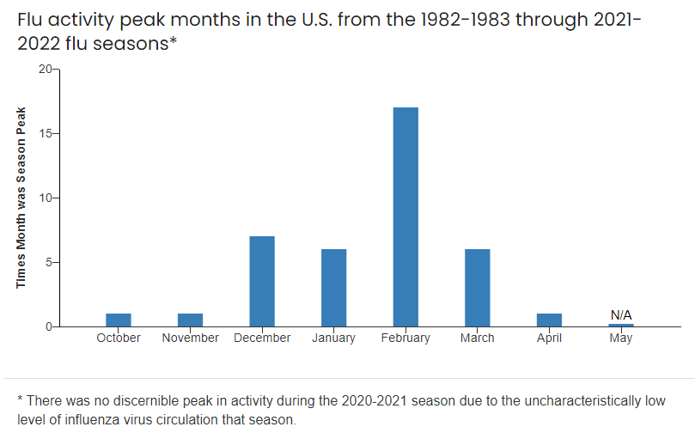
Influenza Vaccination
All flu vaccines for the 2024-2025 season are anticipated to be trivalent in the United States.
Routine annual influenza vaccination of all persons aged ≥6 months who do not have contraindications continues to be recommended.
The vaccines for the ‘23-24 flu season are 41% to 44% effective in preventing flu-related hospitalization in adults
Grohskopf LA, Ferdinands JM, Blanton LH, Broder KR, Loehr J. Prevention and Control of Seasonal Influenza with Vaccines: Recommendations of the Advisory Committee on Immunization Practices — United States, 2024–25 Influenza Season. MMWR Recomm Rep 2024;73(No. RR-5):1–25. DOI: http://dx.doi.org/10.15585/mmwr.rr7305a1

Slide 27
Influenza Vaccination
For most persons who need only 1 dose of influenza vaccine for the season, vaccination should ideally be offered during September or October. However, vaccination should continue after October and throughout the influenza season as long as influenza viruses are circulating and unexpired vaccine is available.
ACIP recommends that adults aged ≥65 years preferentially receive any one of the higher dose or adjuvanted influenza vaccines.
Solid organ transplant recipients aged 18 through 64 years who are receiving immunosuppressive medication regimens may receive either HD-IIV3 or aIIV3 (high dose) as acceptable options
A history of Guillain-Barré syndrome (GBS) within 6 weeks of a previous dose of any type of influenza vaccine is considered a precaution for influenza vaccination
Grohskopf LA, Ferdinands JM, Blanton LH, Broder KR, Loehr J. Prevention and Control of Seasonal Influenza with Vaccines: Recommendations of the Advisory Committee on Immunization Practices — United States, 2024–25 Influenza Season. MMWR Recomm Rep 2024;73(No. RR-5):1–25. DOI: http://dx.doi.org/10.15585/mmwr.rr7305a1

Slide 28
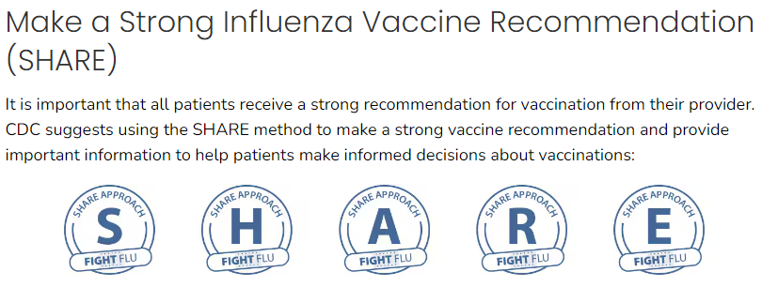
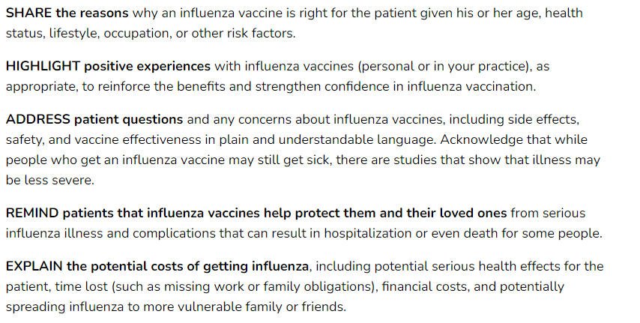

Slide 29
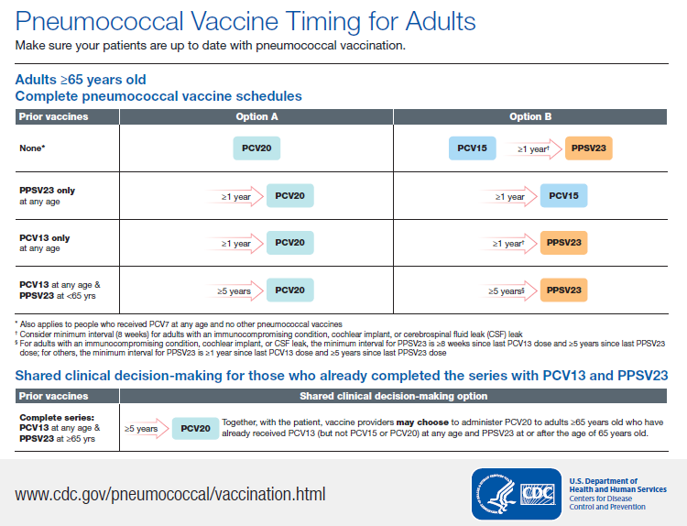
Vaccine efficacy – around 60-70% prevention of invasive pneumococcal disease.

Slide 30
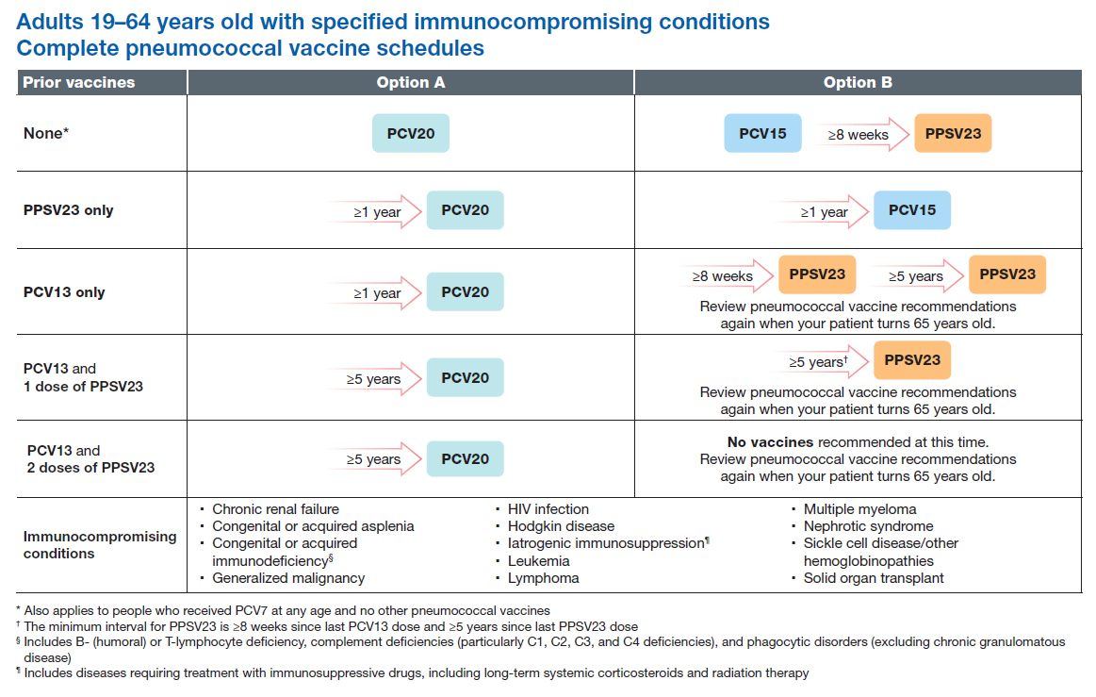
PCV20

Slide 31
Hepatitis Vaccinations
Hepatitis A
Adults who were not vaccinated previously and want to be protected against hepatitis A can also get the vaccine.
  Risks:
    Travelers to endemic countries
    MSM
    IVDU
    Chronic liver dz; Hep B/C
    HIV
    Occupational risk
  Can be considered for anyone; 2 shots 6 months apart
  Use Twinrix if nonimmune to Hep A and Hep B
  Repeat vaccination in those who are not immune after first set of vaccinations

Slide 32
Hepatitis Vaccinations
Hepatitis B
  Recommended vaccine for:
    All children and adolescents younger than 19 who have not been vaccinated.
    Adults 19–59.
    Adults 60 and older with risk factors for hepatitis B.
  Check Hep A/B/C serology on all new members
    HEPATITIS PANEL, GENERAL/CHRONIC (6462)
  All patients without evidence of Hepatitis B past or present infection (Hep B surface Ab +)
  If isolated anti Hep B core Ab+, check Hep B DNA (especially in HIV patients)

Slide 33
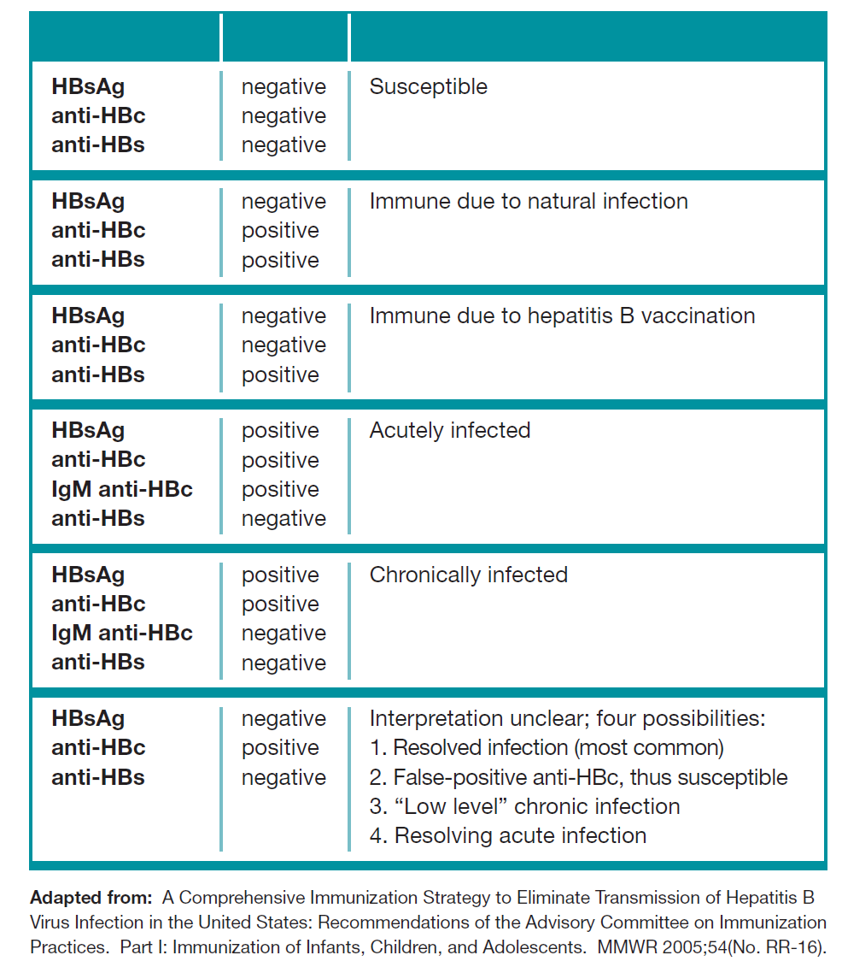
In this situation check HBV DNA, and vaccinate if negative

Slide 34
Hepatitis B
Summary of Recommendations
For Vaccination
HepB vaccine intramuscular (IM) or Recombivax HB 20 mcg [two injections of 10 mcg each]) at 0, 1, and 6 months (these doses are considered a “double-dose” three-dose series) (AII); or
Combined HepA and HepB vaccine IM as a three-dose series (at 0, 1, and 6 months) (AII);or
Vaccine conjugated to CpG IM at 0 and 1 months for vaccine-naive patients (AII).
Anti-HBs should be obtained 1 to 2 months after completion of the vaccine series.

Slide 35
Varicella Vaccination
Recommend vaccination for varicella if >8 years old, and CD4 >200 and no evidence of immunity (or history of infection)
  2 shots 3 months apart
  Varicella Zoster Ig if nonimmune and exposed

Slide 36
Shingles Vaccination
Vaccination is over 90% effective at preventing shingles and postherpetic neuralgia in adults 50 years and older with healthy immune systems.
Adults 19 years and older who have weakened immune systems are at higher risk of complications and should also vaccinated.
  Cancer, HIV, HSCT, solid organ transplant, cancer, inflammatory and autoimmune disorders (especially immunomodulating agents)
CDC recommends 2 doses of recombinant zoster vaccine (RZV) to prevent shingles and related complications in adults aged ≥50 years.
  2 shots 2-6 months apart
  Should give even if received Zostavax in the past
HIV:
  Shingles vaccine should be given to all patients >19 with regardless of CD4
  Can consider waiting until CD4 >200 and VL suppressed on ARVs

Slide 37
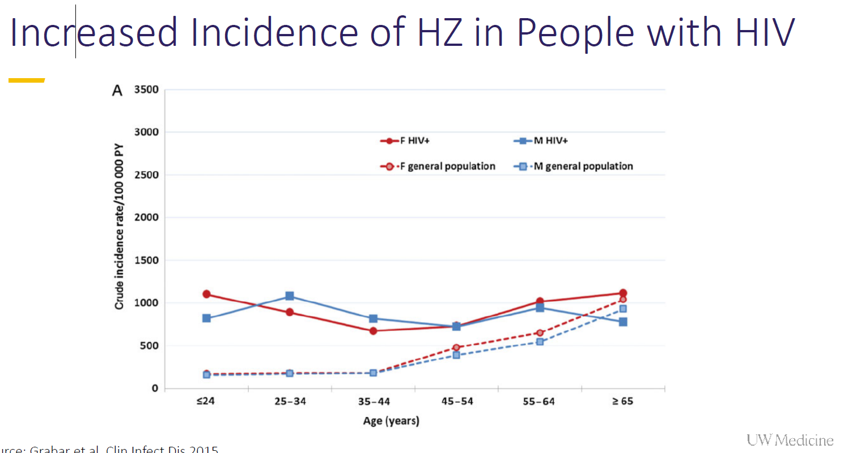
Shingles Vaccine

Slide 38
HPV vaccine
Ages 9-26 for everyone
  3 shot series
Age 27-45 if no evidence of vaccination should be offered vaccination if appropriate
  From Guidelines:
    Routine vaccination is not recommended for people ages 27–45 years (AI). Some people with HIV may benefit from vaccination in this age group, and shared clinical decision-making between the provider and patient is recommended in these situations.

Slide 39
Meningitis Vaccination
Meningococcal Vaccine
Summary of Recommendations
Administer two doses of quadrivalent meningococcal conjugate vaccine at least 8 weeks apart to all people with HIV age ≥18 years (AII).
For people with HIV receiving primary vaccination, administer two doses at least 8 weeks apart.
For individuals with HIV who have been vaccinated previously and are age ≥7 years, repeat vaccination every 5 years throughout life (BIII).
At this time, serogroup B meningococcal vaccination (MenB) is not routinely indicated for adults and adolescents with HIV.
New recommendation in 2016 for meningococcal vaccination in HIV patients, as they have an increased risk of invasive meningococcal disease as opposed to the general population
Initially was recommendation for MSM in NYC in 2013

Slide 40
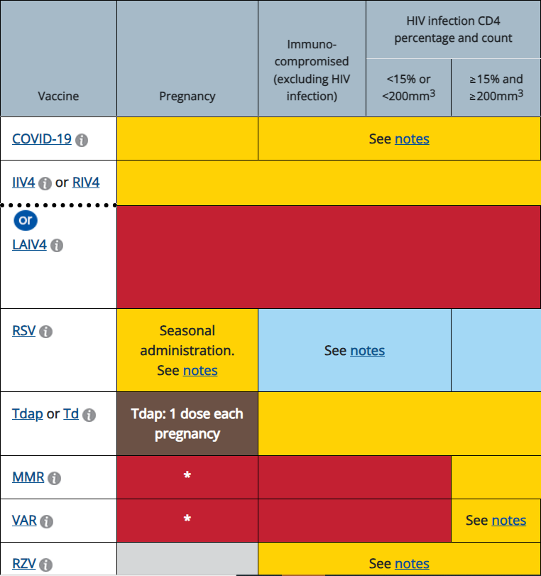
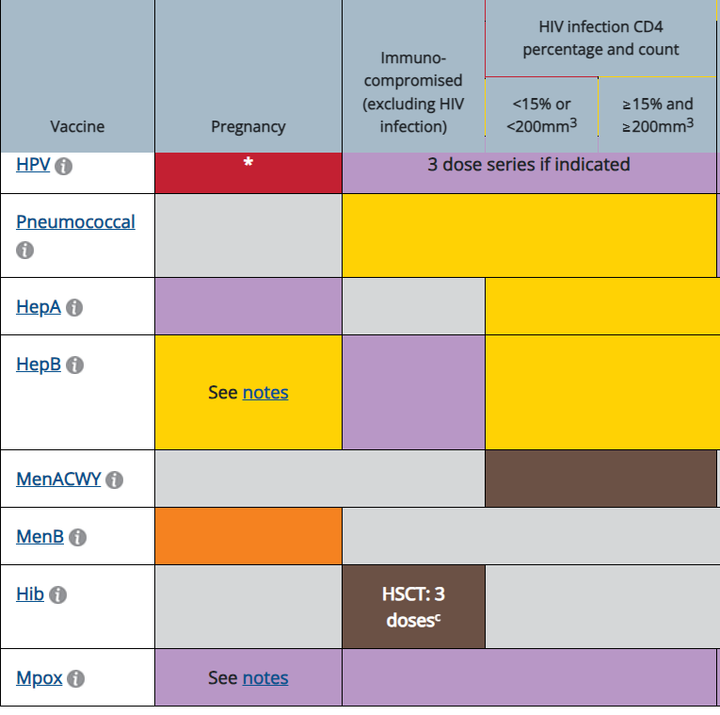
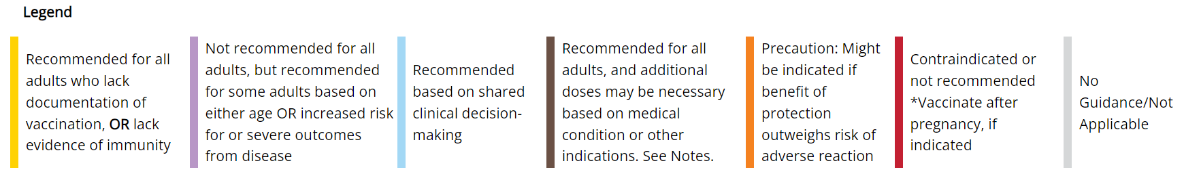
CDC/ACIP Guidelines for Adult Immunizations – Patients with HIV

Slide 41
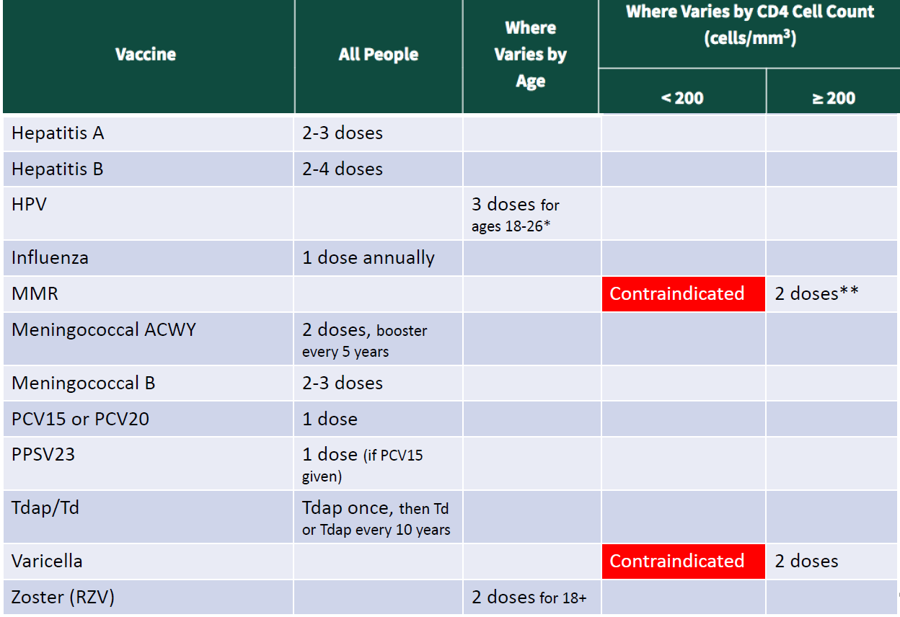

Slide 42
Mpox Vaccination
Summary of Recommendations
For Vaccination
  Mpox vaccination with live nonreplicating vaccinia vaccine should be offered to all people with HIV who have potential for mpox exposure or anticipate potential exposure to mpox per CDC interim clinical considerations (BII), as well as any other people with HIV who request vaccination (CII).
  Mpox vaccination is the preferred vaccine before mpox exposure and is safe to use in people with HIV; administer Mpox vaccination in two doses (0.1 mL ID or 0.5 mL SQ) 4 weeks (28 days) apart (AII).
  If the second dose is not administered during the recommended interval, it should be administered as soon as possible (CIII). There is no need to restart or add doses to the series if there is an extended interval between doses (CIII).
  People who had received smallpox vaccination more than 10 years ago should still receive two doses. (CIII).
  Administration of live replicating vaccinia vaccines (i.e., ACAM2000) to pregnant, breastfeeding, or immunocompromised individuals, including people with HIV, is contraindicated (AII).
For Post-exposure Prophylaxis
  For unvaccinated people with HIV who experience a known or presumed exposure, administer a complete series as soon as possible, ideally within 4 to 14 days after exposure (BII).

Slide 43
RSV vaccine
CDC recommends all adults ages 75 and older get an RSV vaccine (new rec in 7/24).
CDC recommends RSV vaccines for all adults ages 60-74 who are at increased risk of severe RSV disease.
  Have chronic heart or lung disease
  Have a weakened immune system
  Have certain other medical conditions, including severe obesity and severe diabetes
  Live in a nursing home or other long-term care facility
An RSV maternal vaccine is available for pregnant mothers at weeks 32-36 of pregnancy, passing on protection to their baby.
The RSV vaccine is given as a single dose.
During clinical trials, RSV vaccines for people ages 60 and older reduced the risk of symptomatic lower respiratory tract disease by 80%-90% in the first season after RSV vaccination.

Slide 44
Women's Issues
All women with HIV of childbearing age should be asked routinely about desire for pregnancy
Mammogram
Hormone replacement therapy not routinely recommended
Cervical cancer screening

Slide 45
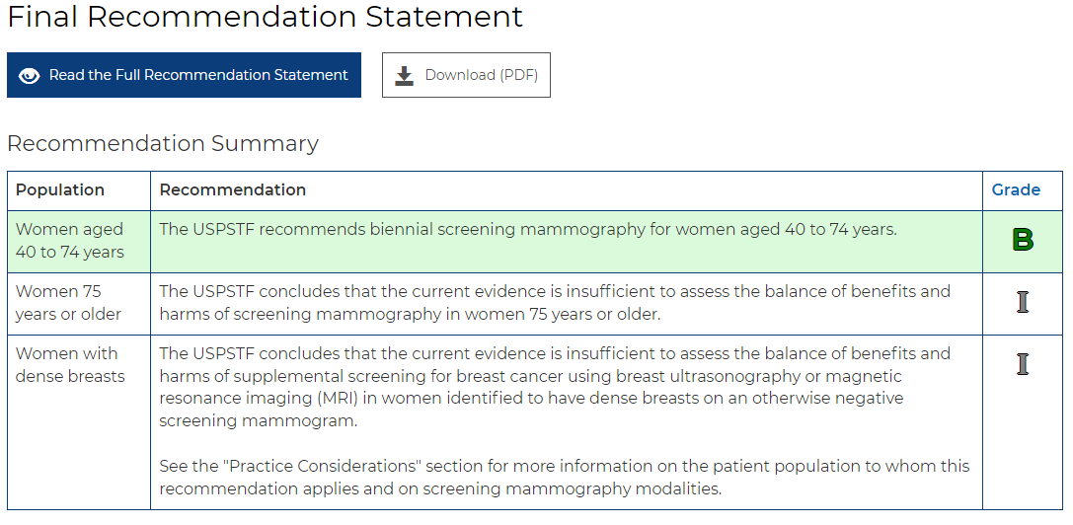
Mammogram Guidelines
ACS: Women between 40 and 44 have the option to start screening with a mammogram every year.
Women 45 to 54 should get mammograms every year.
Women 55 and older can switch to a mammogram every other year, or they can choose to continue yearly mammograms. Screening should continue as long as a woman is in good health and is expected to live at least 10 more years.

Slide 46
Pregnancy
All pregnant women should be treated for HIV regardless of immune status, to prevent transmission to fetus
Infants exposed to HIV in utero should get postexposure prophylaxis and HIV RNA testing at 14-21 days, 1-2 months and 4-6 months
High risk exposed infants should have VL tested at birth

Slide 47
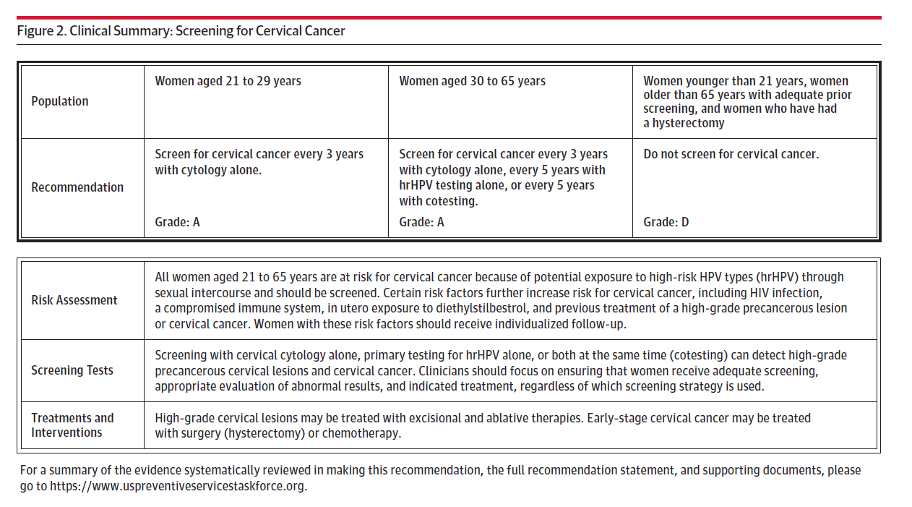
USPSTF Cervical Cancer Screening (non-HIV)

Slide 48
Cervical Pap Smear
Abnormal cervical cytology 10x greater in population with HIV
Initially, 6 months later, and then yearly
If abnormal (ASCUS thru HGSIL) then needs colposcopy
Consider continuing paps of vaginal cytology even if hysterectomy, especially if abnormal cervical cytology pre-hysterectomy
Every 3 years for women with normal pap smears and HPV negative >30 y/o and CD4 >500
  No HPV testing in women under 30 years

Slide 49
NY State AIDS Institute Medical Care Criteria Committee, March 2024
Age-Based Screening
For patients <30 years old, testing for HPV is not recommended (A2†). For these patients, clinicians should perform cervical cytology within at least 2 years of the onset of receptive sexual activity or by age 21 years, regardless of the mode of HIV acquisition (A2), and if cytology results are normal, repeat testing every 3 years. (A2)
For patients ≥30 years old, clinicians should perform cytology/HPV cotesting within 3 years of previous testing. (A2) If the baseline cytology and HPV test results are negative, clinicians should repeat both tests every 3 years thereafter. (A2)
Clinicians should repeat cervical cytology after 2 months but within 4 months after a result of “insufficient specimen for analysis” has been reported. (A3)
Clinicians should continue cervical cancer screening for patients ≥65 years old; however, factors such as a patient’s life expectancy and risk of developing cervical cancer should inform shared decision-making regarding continued screening. (A3)

Slide 50
Metabolic Complications 1
Hyperlipidemia
  Fasting lipids should be obtained prior to and within 1-3 months of starting ARVs
  Statins recommended, but watch with drug interactions; also diet/exercise
DEXA scanning in postmenopausal women and men >50
  Treat with Vit D, Calcium, biphosphanates
    May be due to tenofovir, or
    Vit D deficiency (40-80% HIV patients)

Slide 51
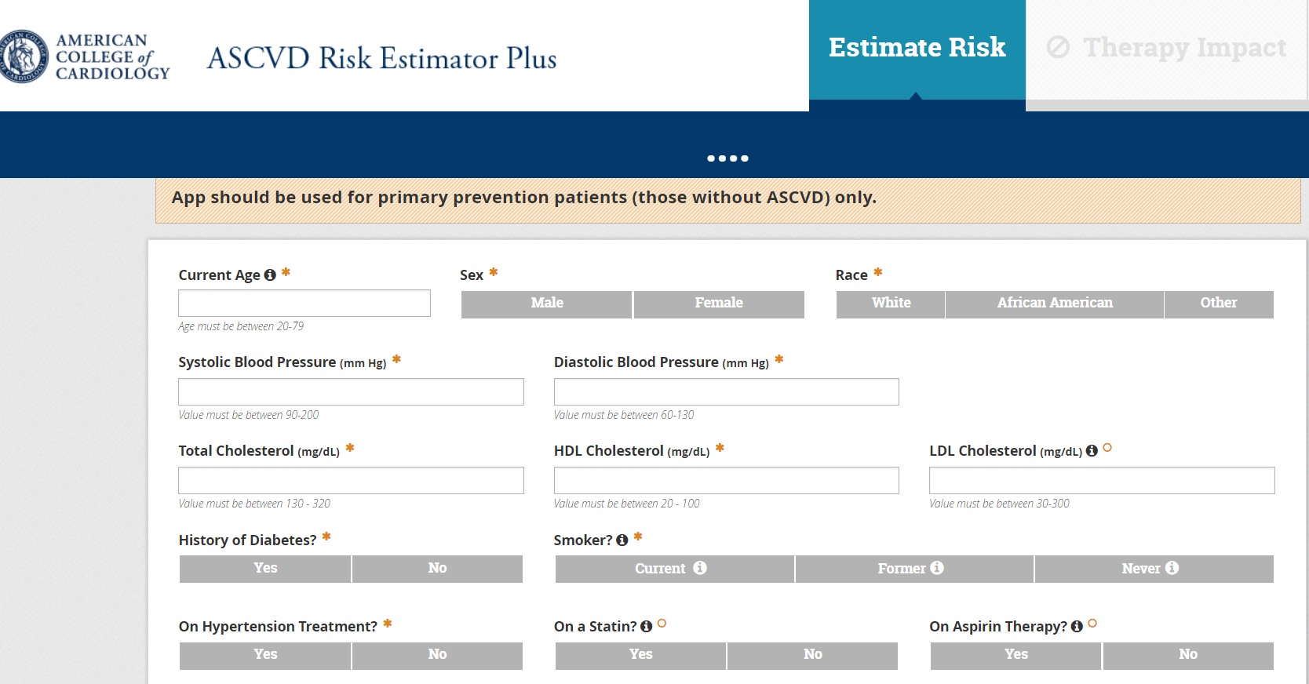
ASCVD Risk Calculator

Slide 52
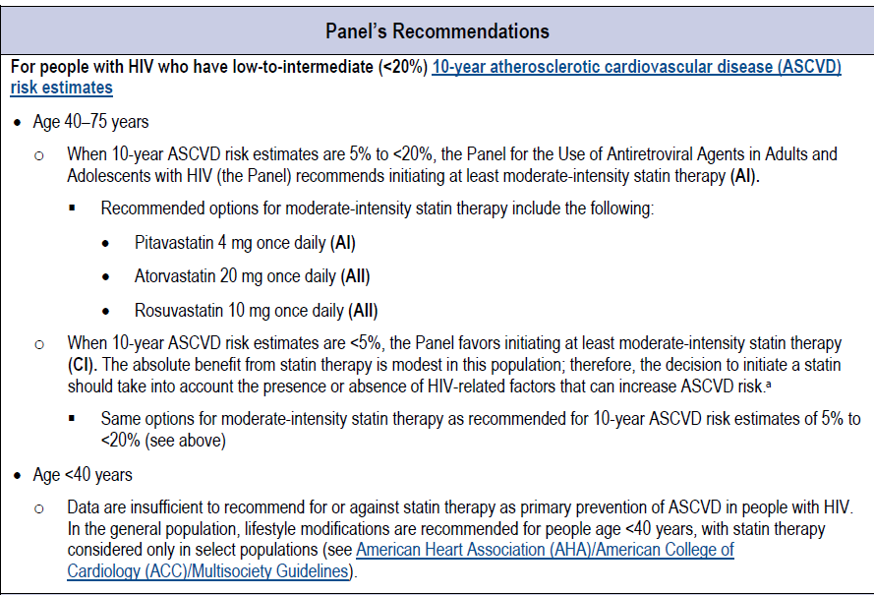
Statin Therapy – New Recommendations

Slide 53
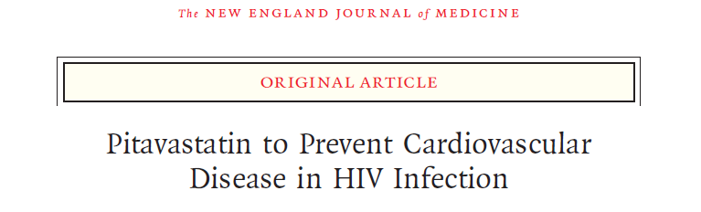
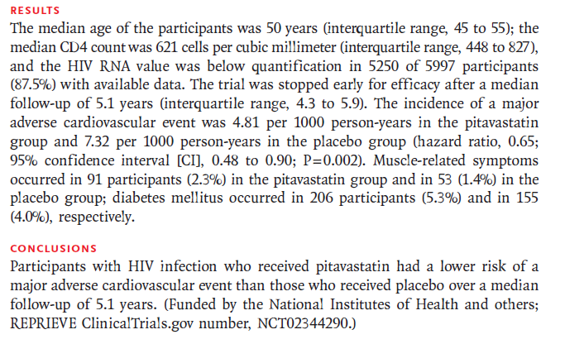

Slide 54
Metabolic Complications 2
Diabetic screening
  Check fasting glucose and/or HgbA1c prior to and within a 1-3 months of starting ARVs
  HgbA1c preferred as difficult to get fasting glucose
    DM = fasting glucose >126 or HgbA1c >6.5%
    5.7%-6.4% = pre-DM
    Weight loss / exercise / dietary modification recommended first line

Slide 55
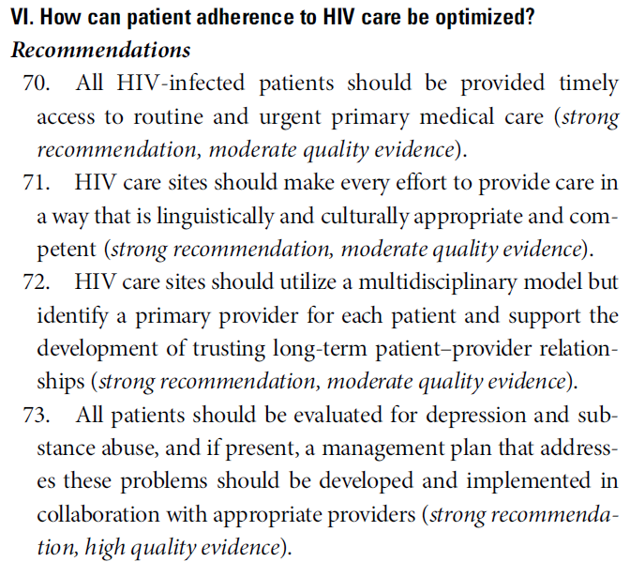
Optimizing Adherence

Slide 56
Renal Function 1
Check UA for proteinuria and creatinine clearance or GFR at initial evaluation and yearly due to increased risk of abnormal kidney function
  30% of all HIV patients have abnormal kidney function
  Trimethoprim, dolutegravir and cobicistat can affect GFR without having deleterious kidney effects

Slide 57
Renal Function 2
  Proteinuria for those with high risk of developing CKD
    Black patients
    CD4 <200
    VL >4000
    Comorbidties:
      HCV, DM, HTN
  If 1+ proteinuria, further workup including
    Nephrology eval
    24 hr urine protein
    Renal sono
    Possible renal bx

Slide 58
STD Screening
GC/Chlamydia
  Initially and yearly; ideally use NAAT
    More frequently if frequent risks
  Vaginal swab for women, urethral / urine for men
  Rectal swab if hx anal receptive sex
  Pharyngeal swab if hx oral receptive sex
    Use NAAT for rectal / pharyngeal
  If positive test; retest 3 months after Rx
  Offer rx to partners of those testing positive

Slide 59
Anal Pap Smear
Who should be tested?
  MSM
  Women with hx genital HPV or abnormal cervical pap
  History of anogenital warts
  Hx receptive anal sex should have annual anal pap
    A lower CD4 count is a risk for progression to cancer
If abnormal pap test, then pursue high resolution anoscopy and treatment
There are no randomized clinical trials that document the value of screening for anal SIL in an at-risk population

Slide 60
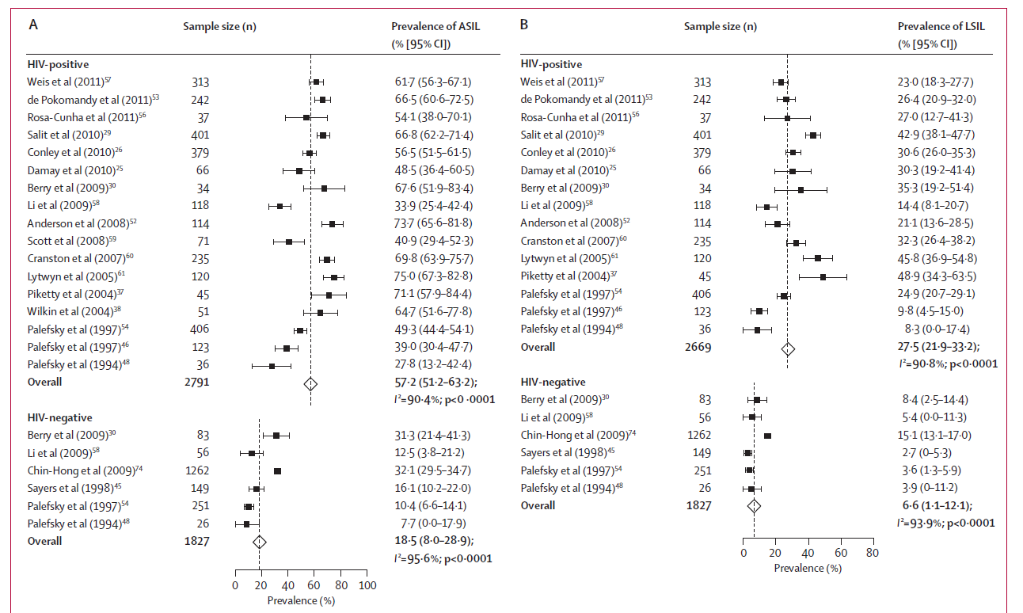
Abnormal Lesion - Prevalence

Slide 61
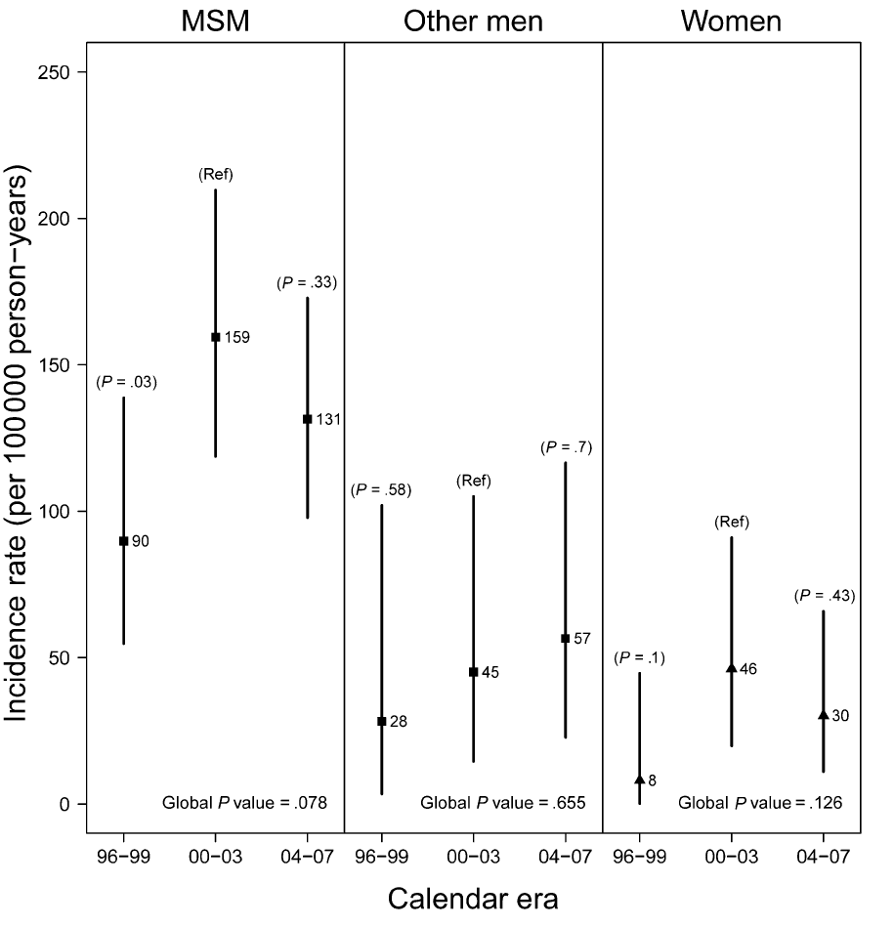
With HIV

Slide 62
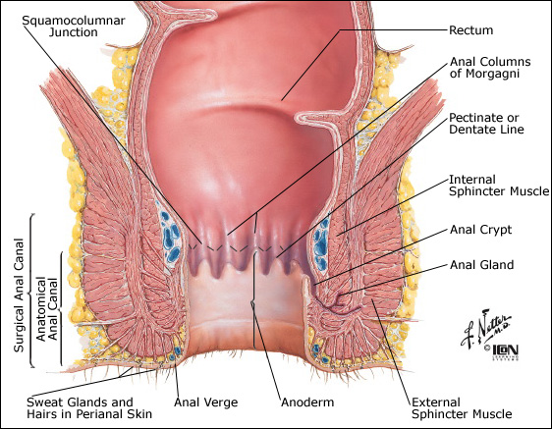
Anal Pap Smear - Anatomy

Slide 63
Anal Pap Smear
May be asymptomatic, but symptoms include
  Pruritis, tenesmus, bleeding etc
Nomenclature similar to cervical pap
  LSIL = AIN 1
  HSIL = AIN 2,3
    Premalignant, may progress to anal cancer
  ASCUS
In non-HIV MSM; 15% with LSIL; 5% with HSIL
20% of MSM with HIV with LSIL will progress to HSIL in 2 years

Slide 64
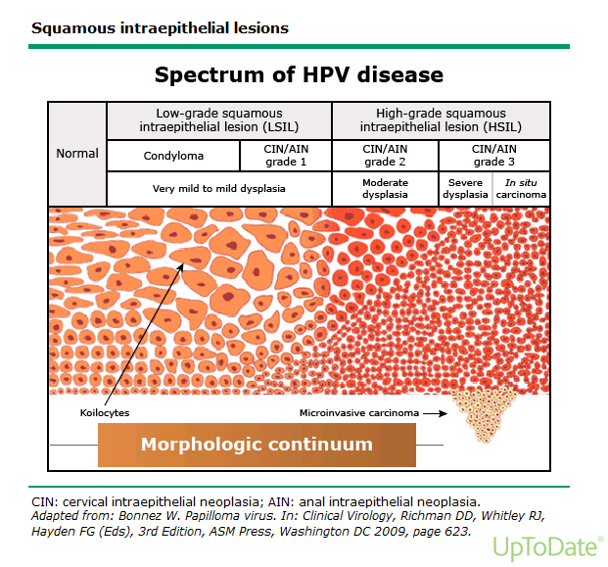

Slide 65
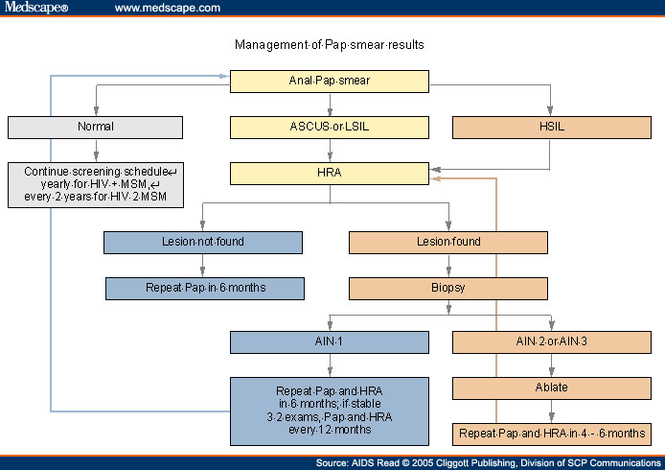

Slide 66
Transgender and Gender Diverse Populations
Recommendations
Transgender and gender-diverse persons with HIV should have access to gender-affirming, nondiscriminatory, non-stigmatizing, and culturally sensitive care.
Intake forms, medical records, and other documentation should integrate gender-neutral language and include gender identity options rather than be limited to sex at birth.
Transgender persons should be offered medical and/or surgical therapy in order to achieve their desired gender characteristics, in accordance with the World Professional Association for Transgender Health (WPATH) standards of care. HIV care providers should be familiar with initial laboratory monitoring and gender-affirming hormone treatment or provide referral to a clinician or endocrinologist experienced in transgender care.
Cancer screening should be conducted based on guidelines for the organs and tissues present in the individual.

Slide 67
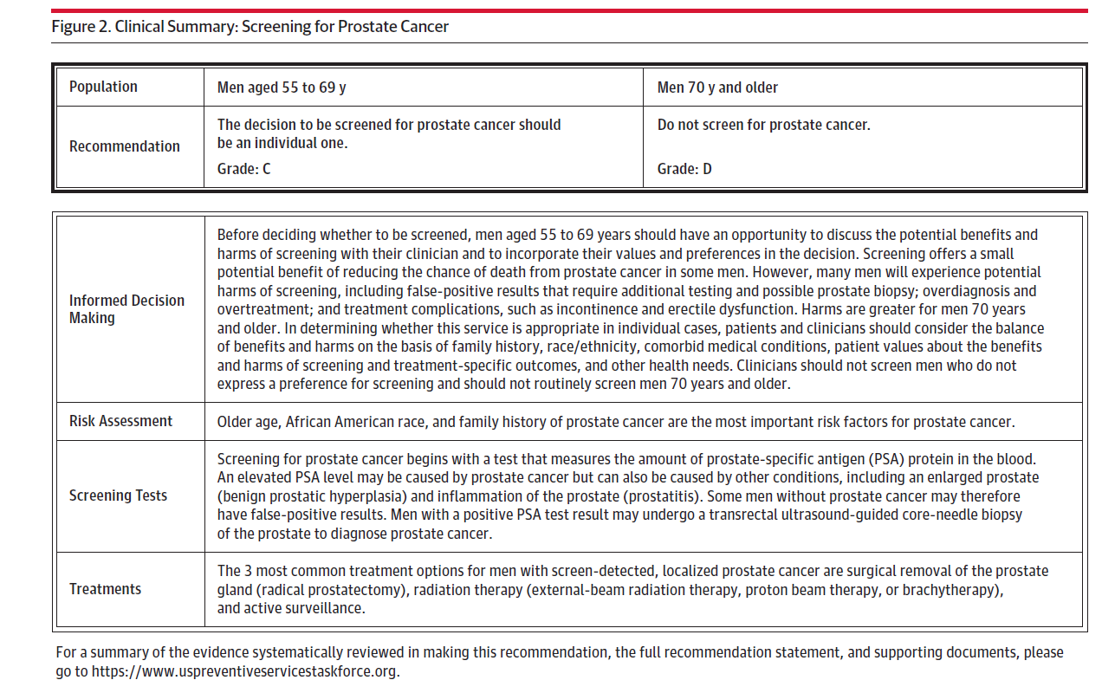
Prostate Cancer Screening

Slide 68
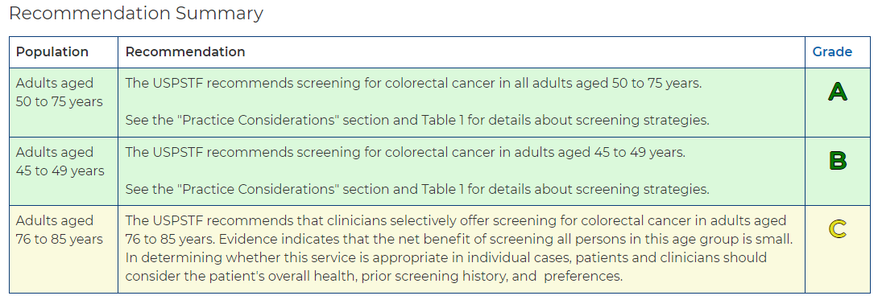
Colorectal Cancer Screening

Slide 69
Other HIV Recommendations
Annual ophtho screening for CD4 <50
Dental evaluations every 6 months
Annual screening for depression (PHQ-2)
Viral hepatitis screening if abnormal LFTs in someone nonimmune, or persistent risk factors / repeated exposure

Slide 70

The End!

Slide 71
MidAtlantic AIDS Education and Training Center - Contact Information
Regional Partner:
Howard University
Rodney Lewis Jr.-Program Coordinator
Anthony Green- Sr. Training Coordinator
Stacy White- Administrative Coordinator
2300 4th Street NW
Washington, DC 20059
(202) 806-0222
Headquarters:
MidAtlantic AIDS Education and Training Center
Department of Infectious Diseases and Microbiology,
School of Public Health,
University of Pittsburgh
412-624-1895
maaetc@pitt.edu
www.maaetc.org
Linda Rose Frank, PHD, MSN, ACRN, FAAN
Principal Investigator and Program Director
Professor of Public Health, Medicine & Nursing
University of Pittsburgh

